Slide 1

Automated Fraud Detection and Monitoring for Claims
Meena Anantha Padmanabhan
December 2018

Slide 2
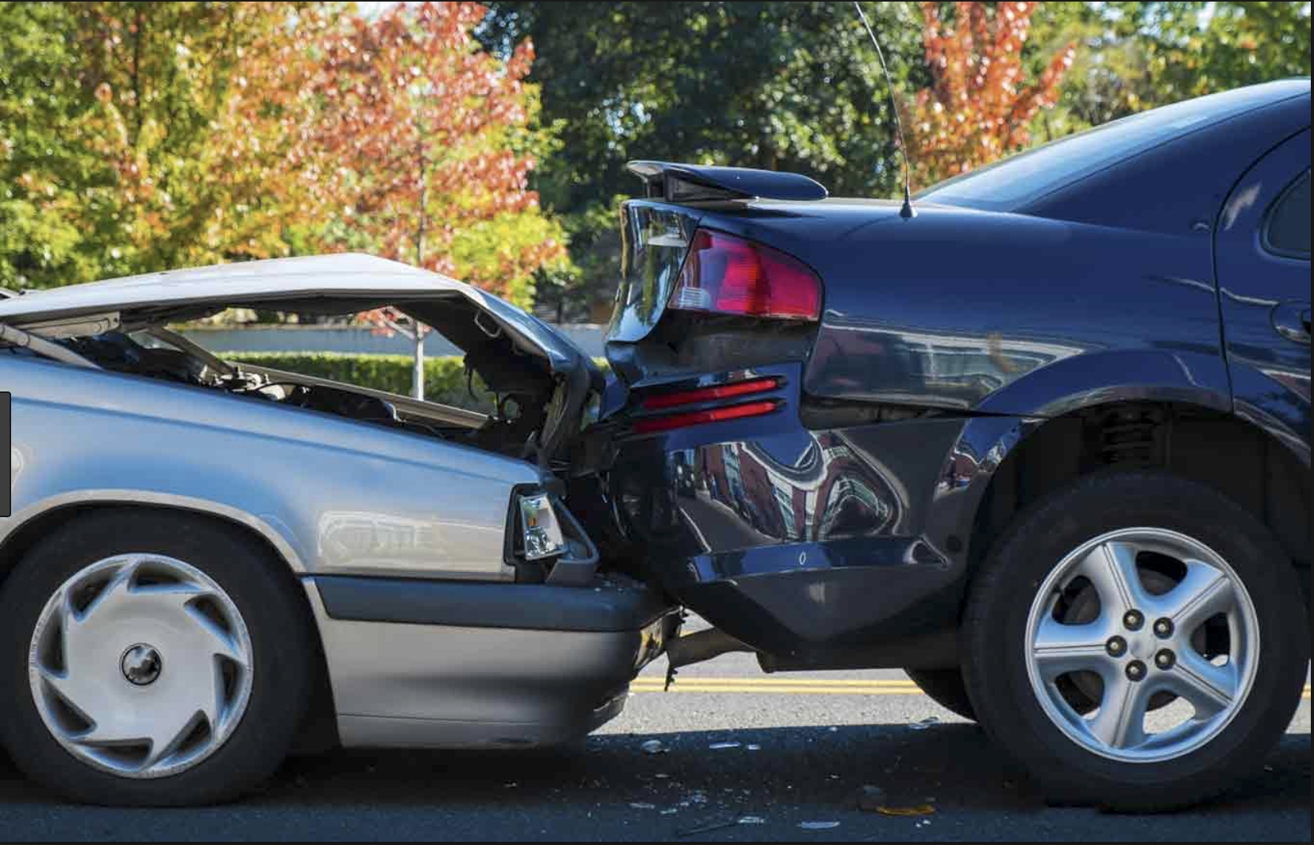

Problem Statement
Conservatively, fraud steals $80 billion a year across all lines of insurance
Traditional fraud detection methods involve manual reviews and rule based screening
- High occurrence of false positives
- Time consuming
Notes:
Traditional methods of data analysis have long been used to detect fraud
They require complex and time-consuming investigations that deal with different domains of knowledge like financial, economics, business practices and law.
Fraud is an adaptive crime, so it needs special methods of intelligent data analysis to detect and prevent it
As a result, we need more advanced analytics for fraud detection

Slide 3
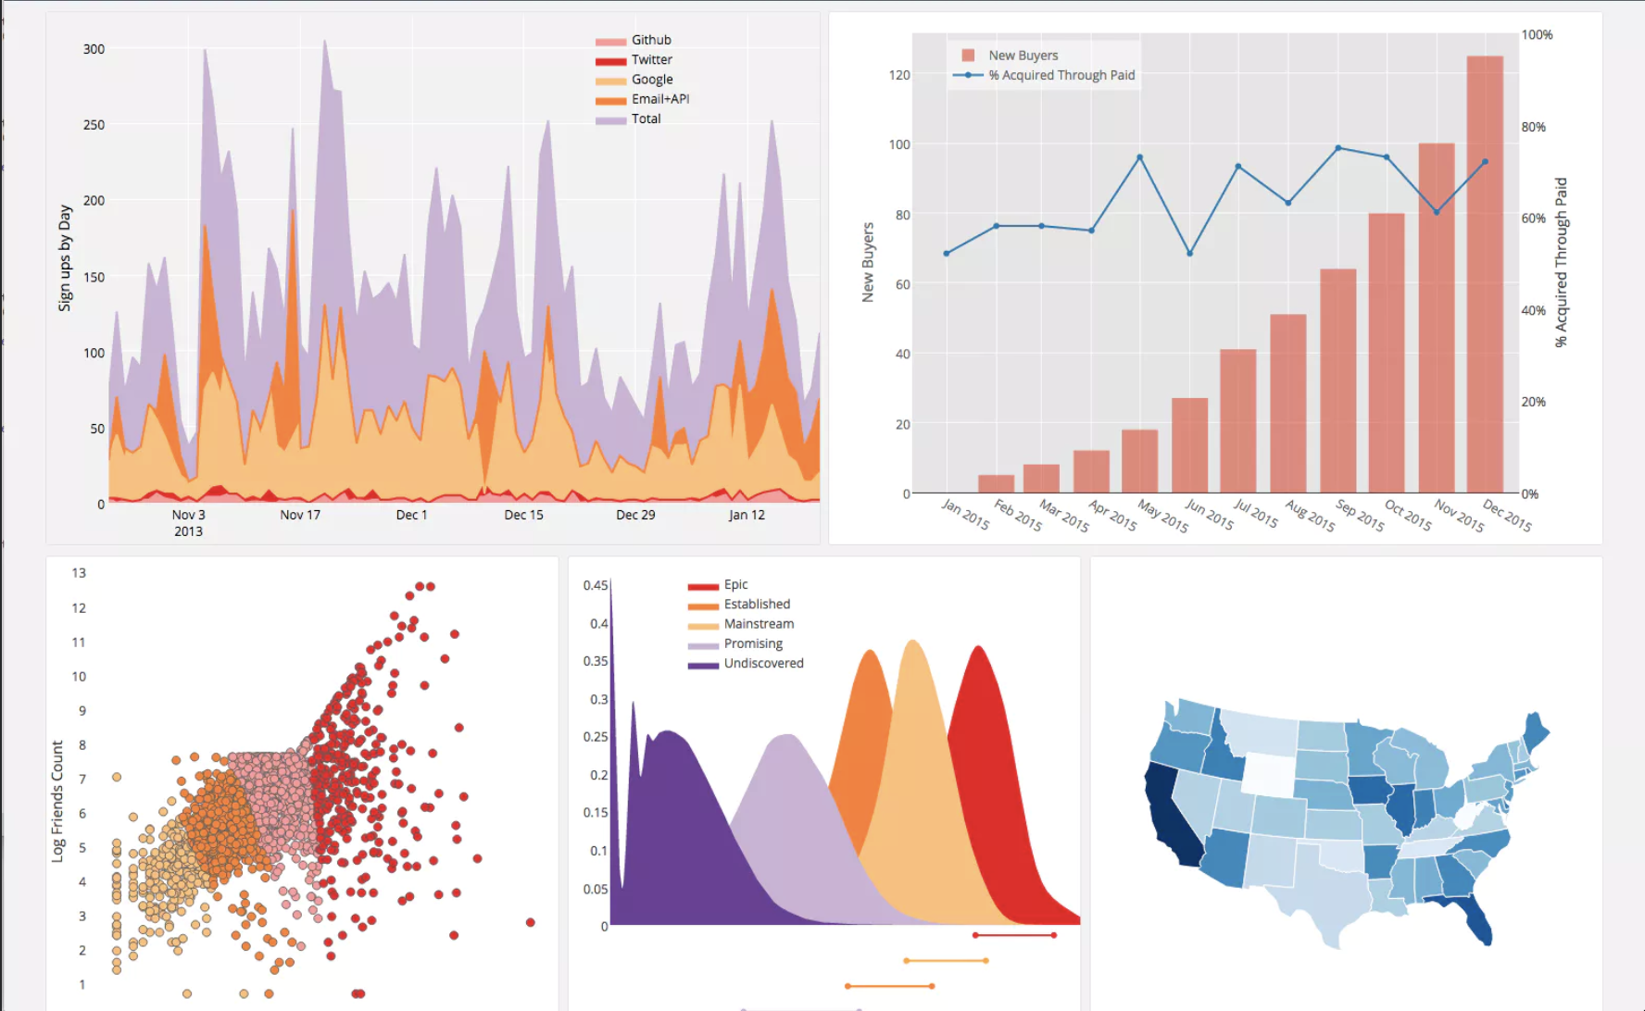
Approach
Classification Algorithms
Classifier1
Classifier-k
Classifier2
Final predictions
Unlabeled data
Ensemble model
Learn the combination from labeled data
AutoML pipeline
training
test
Claims Dashboard
Labeled data
Notes:
I have used an ensemble model to detect fraud.

Slide 4
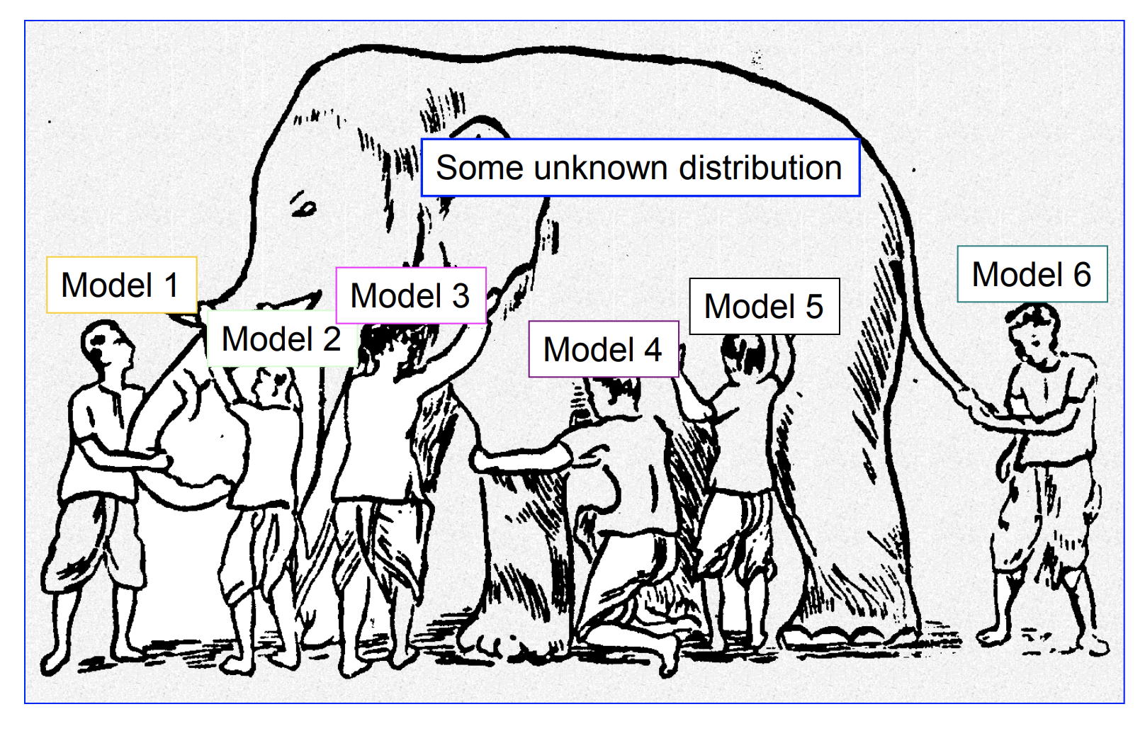
Why use an ensemble model?
Ensemble models give us the full picture!

Slide 5
Dataset
15,420 claims by month
Variables
Time-based: Date of accident, Date of claim
Policy Type
Vehicle information – Age of vehicle, type of vehicle
Area of accident
Demographic information of claimant
Police Report filed – Yes/No

Slide 6
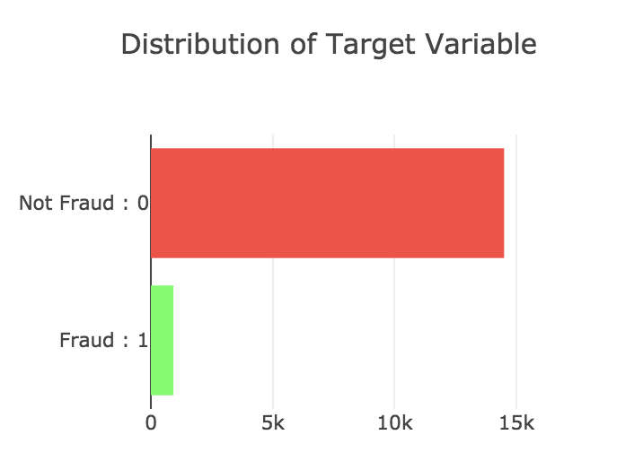
Exploratory data analysis
Vehicle Category | Target = 0 (Non-Fraud) | Target = 1 (Fraud) | Total | %Frauds
Sedan | 8.8K | 0.8K | 9.6K | 8.2%
Sport | 5.2K | 84 | 5.3K | 1.56%
Utility | 347 | 44 | 391 | 11.25%
All | 14.4K | 923 | 15.4K | 5.98%
The target variable is imbalanced with only 6% of the claims being fraudulent
Undersampled the majority class for modeling
Utility vehicles have the highest % of Fraudulent claims
Notes:
Insurers identified potential fraud in 7.4 percent of automobile claims within the first 125 days

Slide 7
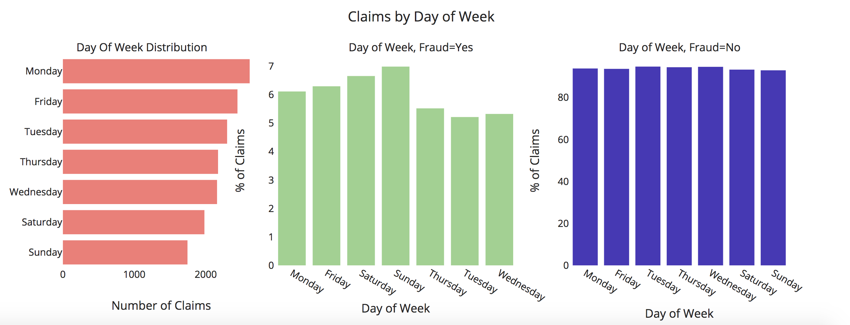
Exploratory data analysis
Sunday has the highest % of fraudulent claims
Monday has the highest number of claims
Notes:
Insurers identified potential fraud in 7.4 percent of automobile claims within the first 125 days

Slide 8
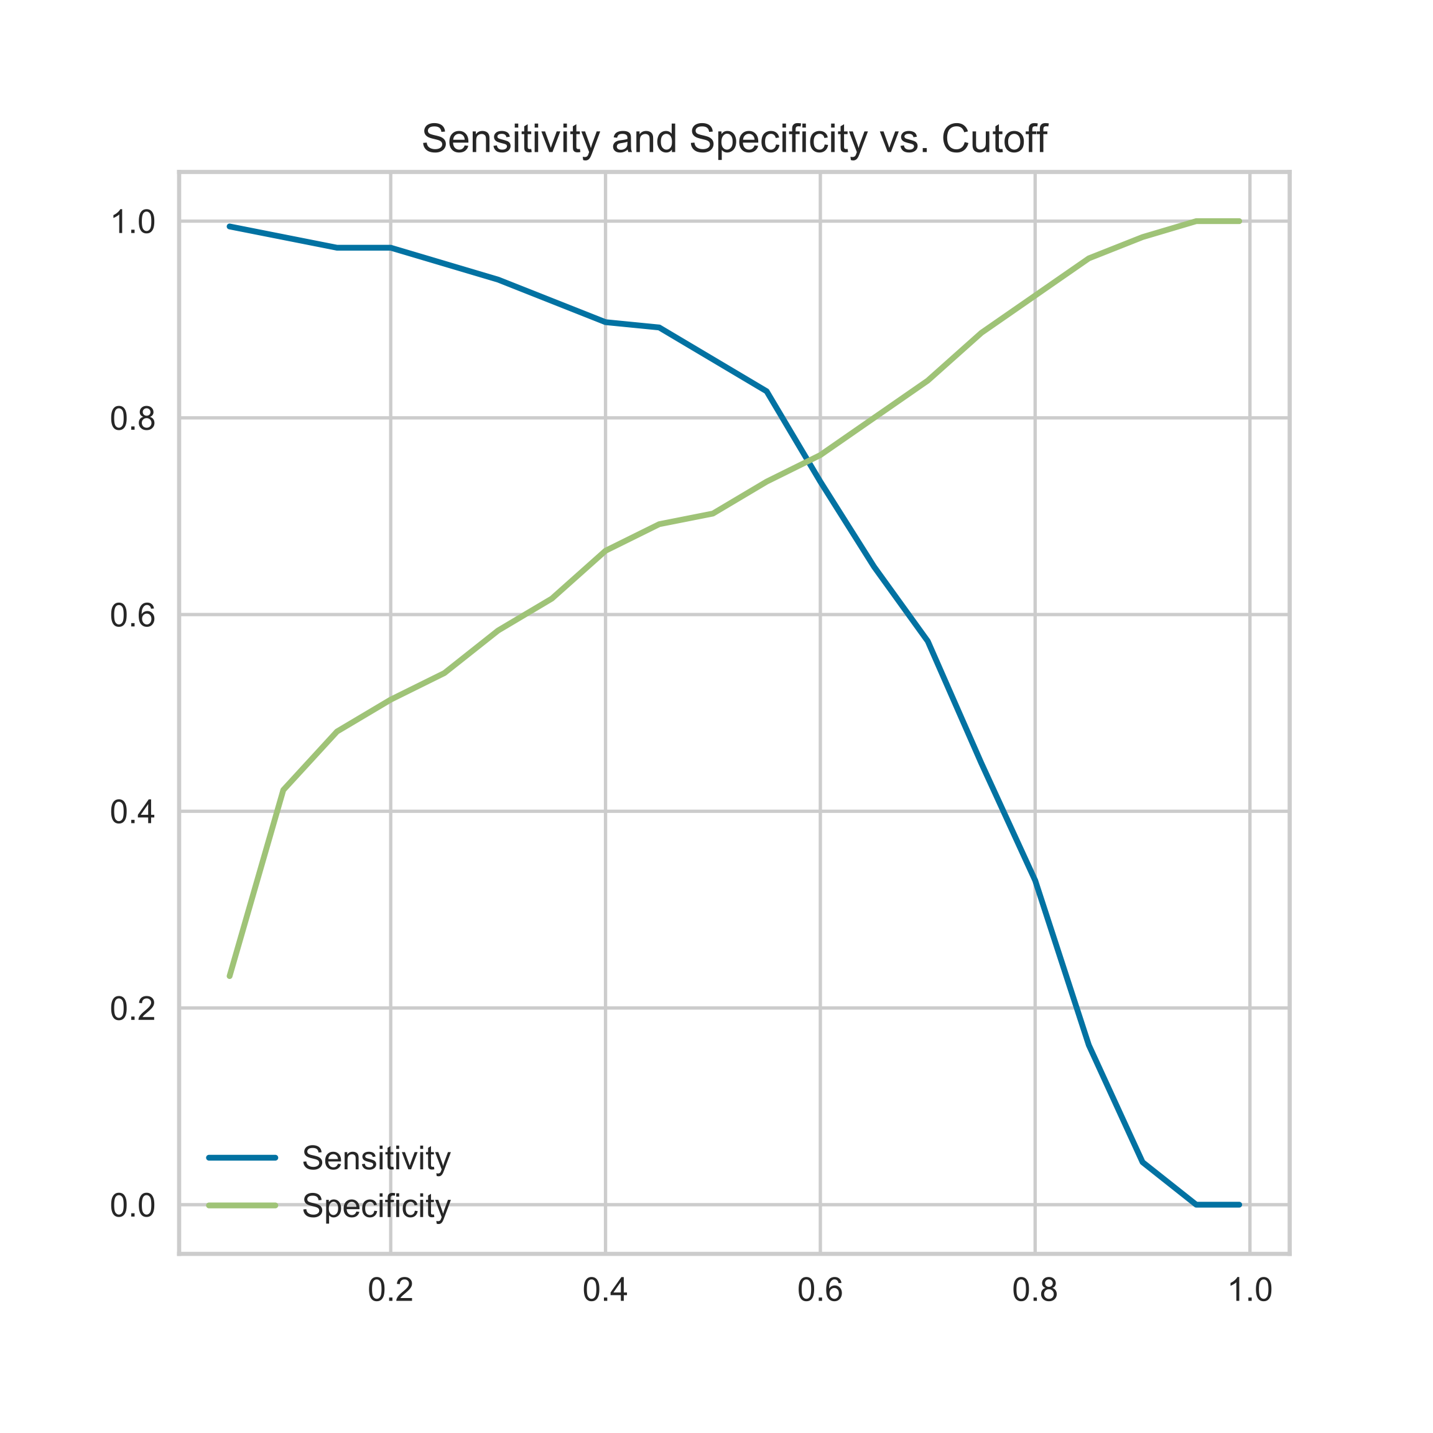
Best Model - Ensemble
Worst model (F1-score) | Average model (F1-score) | Good model (F1-score) | Best Model - Ensemble (F1-score)
0.52 (Naïve Bayes) | 0.71 (Random Forest) | 0.78 (XGBoost) | 0.79
Ensemble model – Probability Cutoff
Ensemble model outperforms the individual models
Probability thresholds are determined based on cost-benefit analysis
Notes:
The model gives the probability of a claim being fraudulent.
In order to select the right threshold above which a claim is
fraudulent,
Use top features of the model
Poorest model in perspective
Tune the model

Slide 9
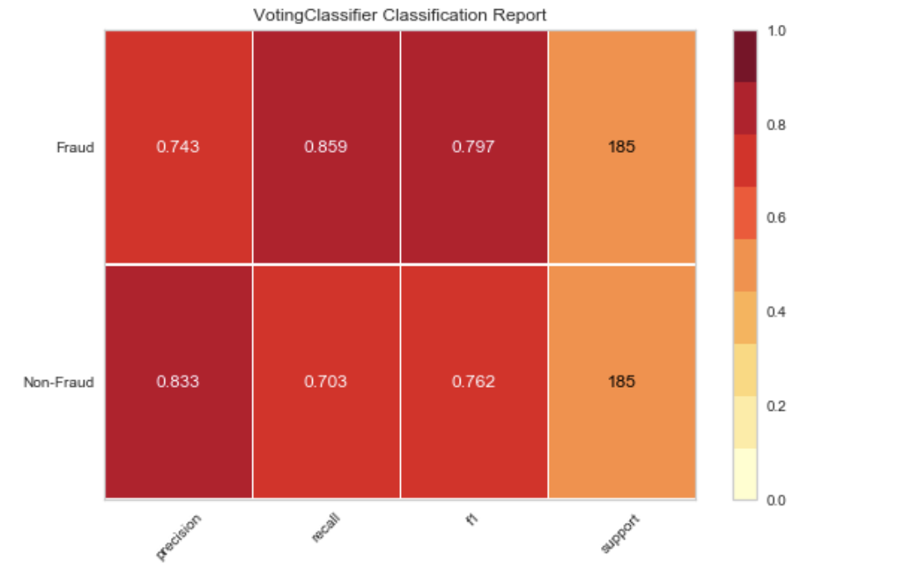
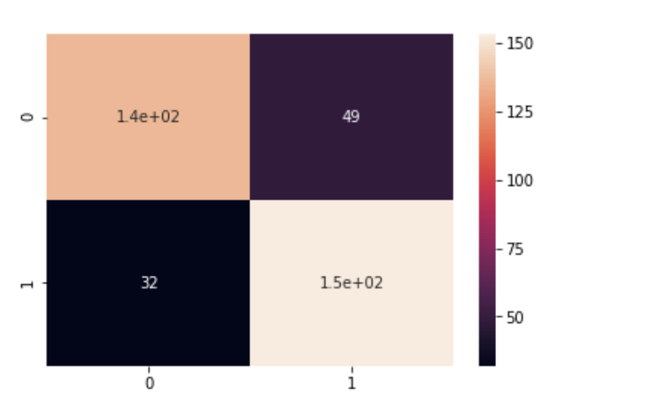
Best Model results
Notes:
Precision – are you predicting only 1s as 1s.
Recall – Out of all the fraudulent cases, how many are you able to predict as 1.

Slide 10
Cost Benefit Analysis – Choosing the probability threshold
 | Cost | Number of claims
Cost of a Fraudulent claim going unnoticed (False Negative) | $5,000 | 32
Cost of identifying a legitimate claim as a fraudulent claim (False Positive) | $10,000 | 49
Net Loss with p-threshold = 0.55 | $650,000
Mis-classification cost of fraudulent claims
Net Loss for various p-thresholds
0.45 | 0.55 | 0.65
$670,000 | $650,000 | $695,000
Notes:
We also risk losing the customer

Slide 11
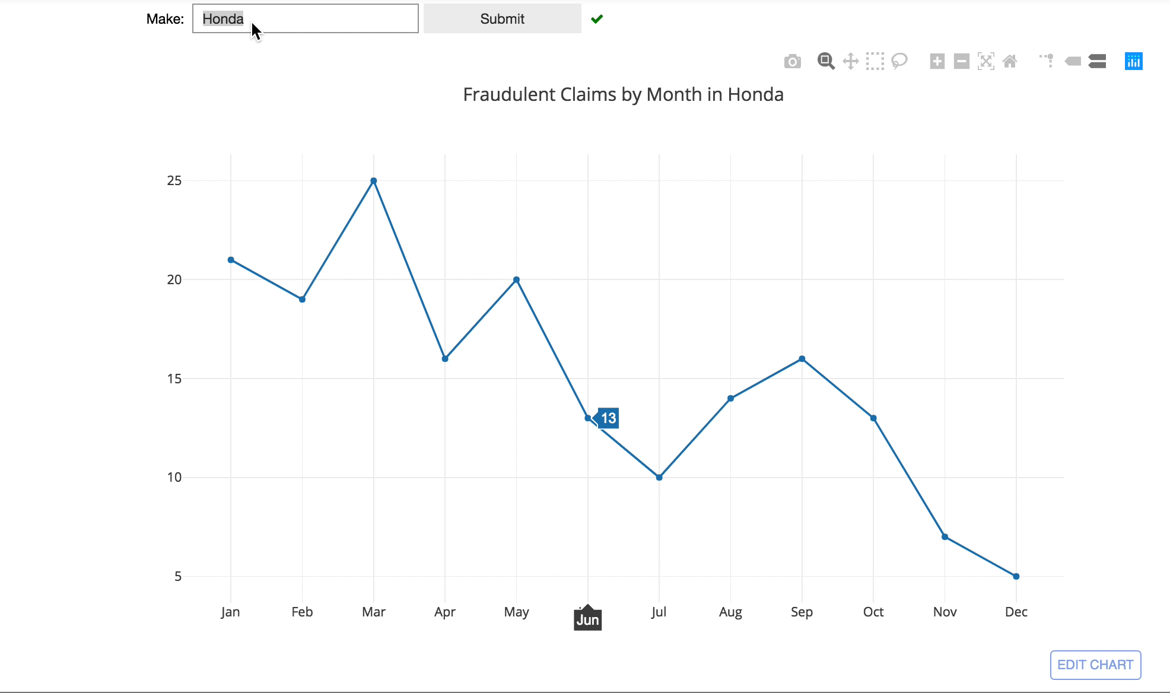
Interactive Claims Dashboard
Notes:
Prioritize which claimant to call and investigate

Slide 12
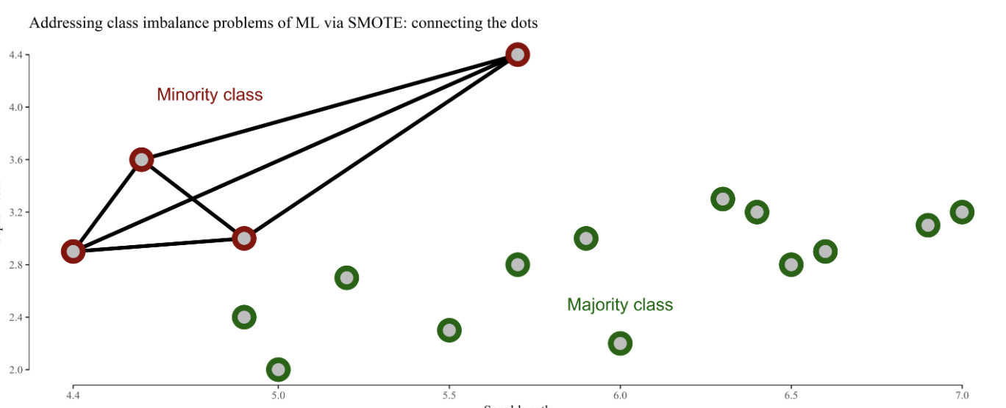
Appendix

Slide 13


linkedin.com/in/meena-ap
ame2005/Projects
Thank you!
Notes:
Linkedin username
Github – username
Picture

